Slide 1
Identifying optimal location for indian restaurant in NYC

Slide 2
Identifying the right location for a new restaurant is key for business owners
Identifying the right location is the first key step in establishing a restaurant
Understanding the high and low density areas for all restaurants and also of specific cuisine, will be determining the future success
Deciding on the location will be based on the distance of other restaurants in the area.

Slide 3
Data Acquisition and Cleaning
Based on definition of our problem, factors that will influence our decision are:
number of existing restaurants in each of the three neighborhoods (any type of restaurant)
number of and distance to Indian restaurants in each of the neighborhoods, if any
distance of neighborhood from Manhattan
We decided to use regularly spaced grid of locations, centered around Manhattan, NY, to define our neighborhoods.
Following data sources will be needed to extract/generate the required information:
centers of candidate areas will be generated algorithmically and approximate addresses of centers of those areas will be obtained using Google Maps API reverse geocoding
number of restaurants and their type and location in every neighborhood will be obtained using Foursquare API

Slide 4
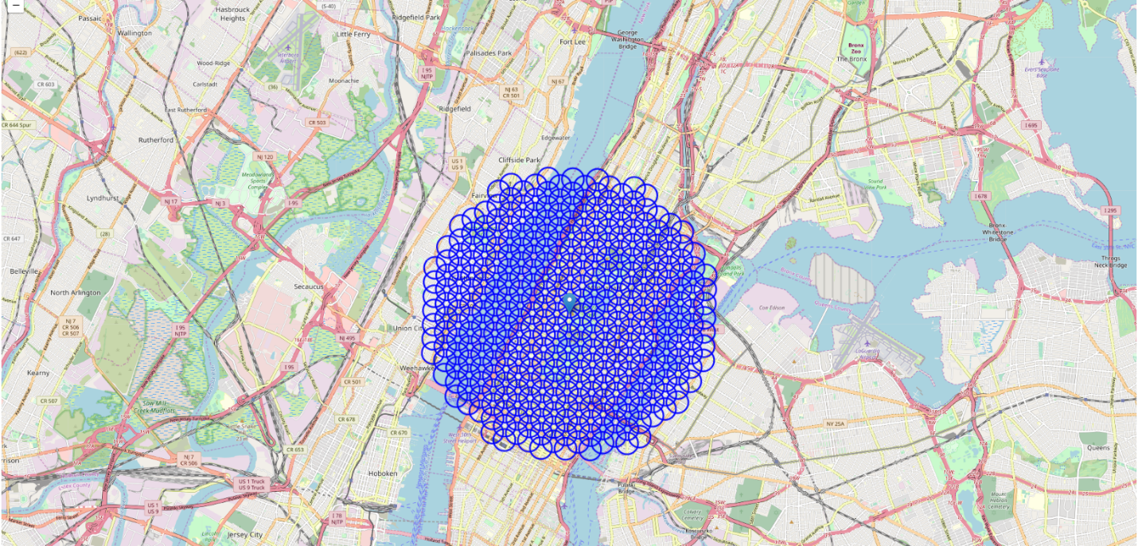
Data Analysis
Neighborhood Candidates
We will create latitude & longitude coordinates for centroids of our candidate neighborhoods. We will create a grid of cells covering our area of interest which is aprox. 12x12 killometers centered around Manhattan.
We will first find the latitude & longitude of Manhattan, using specific, well known address and Google Maps geocoding API.

Slide 5
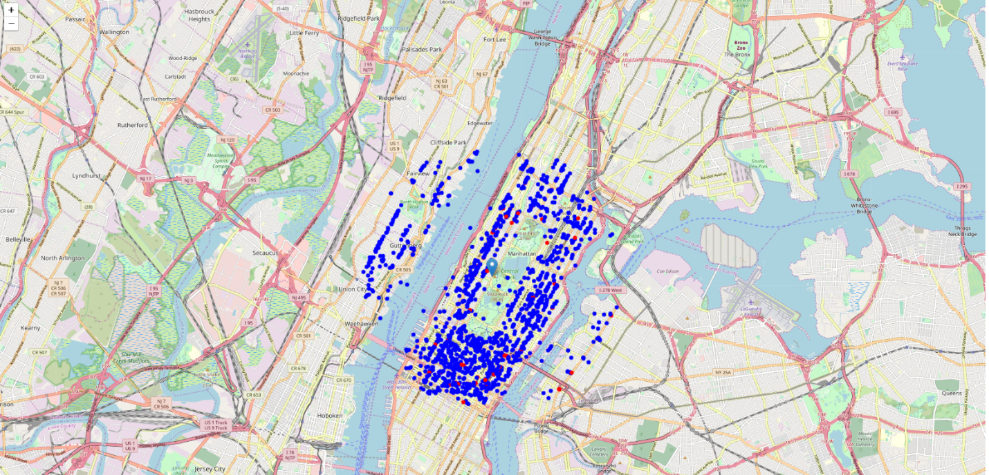
Data Analysis
Foursquare
Now that we have our location candidates, we will use Foursquare API to get info on restaurants in each neighborhood.
We're interested in venues in 'food' category, but only those that are proper restaurants - coffee shops, pizza places, bakeries etc. are not direct competitors so we don't care about those. So we will include in out list only venues that have 'restaurant' in category name, and we'll make sure to detect and include all the subcategories of specific 'Indian restaurant' category, as we need info on Indian restaurants in the neighborhood.

Slide 6
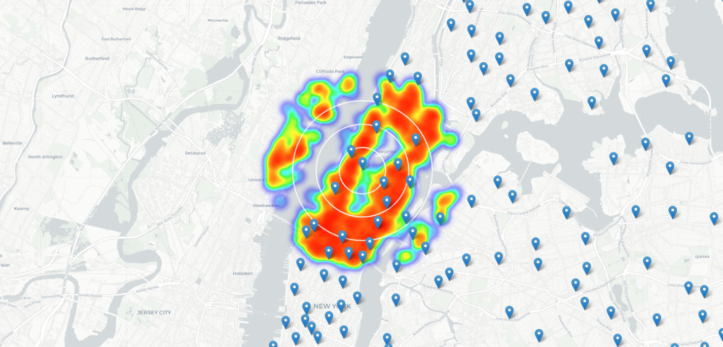
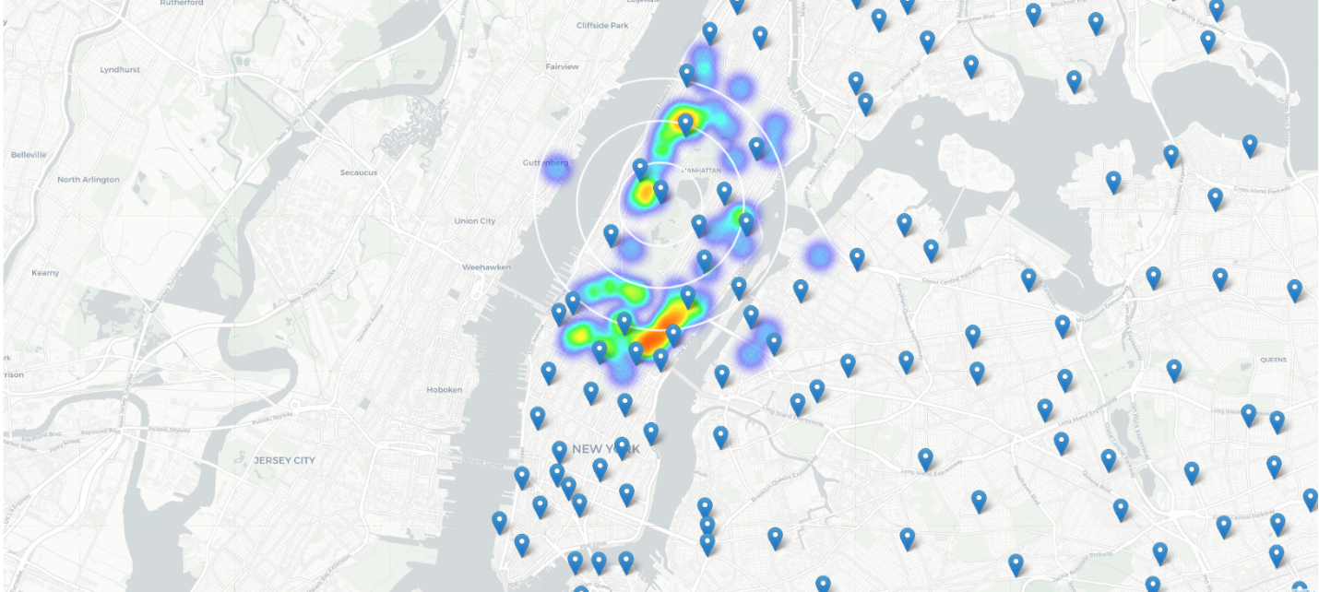
Methodology
Second step in our analysis will be calculation and exploration of 'restaurant density' across different areas of Berlin - we will use heatmaps to identify a few promising areas close to center with low number of restaurants in general (and no Indian restaurants in vicinity) and focus our attention on those areas.

Slide 7
Conlusion
Purpose of this project was to identify NYC areas close to Manhattan with low number of restaurants (particularly Indian restaurants) in order to aid stakeholders in narrowing down the search for optimal location for a new Indian restaurant. Based on our analysis of restaurant density in general around Manhattan and Indian restaurant density in particular, we recommend East Harlem as the preferred location for new Indian Restaurant.

